Slide 1

Predicting Optimal Locations for Solar Panel Deployment in Bangladesh: A GHI-Based Analysis Using Machine Learning

Slide 2
Group members
SK. SHAHED ALI MD ABDUL AZIZ SUMAYA ISLAM JUBAER BIN MURSHED
22-47756-2 22-47013-1 22-47709-2 21-44488-1
supervised by
DR. MD. SAEF ULLAH MIAH

Slide 3

Table Of Contents
Abstract
Introduction
Literature Review
Methodology
Data Analysis
Result
Discussion
Conclusion

Slide 4
abstract
In this study, we aim to identify optimal solar panel installation locations across Bangladesh by leveraging Global Horizontal Irradiance (GHI) data. A comprehensive dataset, encompassing key environmental factors such as temperature, Direct Normal Irradiance (DNI), Diffuse Horizontal Irradiance (DHI), surface albedo, and cloud type, was analyzed using advanced machine learning techniques.
Five predictive models—Linear Regression, Random Forest, Gradient Boosting, Decision Tree, and XGBoost—were evaluated for their accuracy and reliability. Among these, XGBoost demonstrated exceptional performance, achieving the highest R² score (99.493%) and the lowest error metrics (MAE: 0.01226, RMSE: 0.02039). These results underscore the effectiveness of machine learning in deriving actionable insights for renewable energy deployment.
The findings provide a data-driven approach to optimizing solar energy investments in Bangladesh, contributing to sustainable energy solutions and efficient resource management. Future research directions include the integration of socio-economic factors and advanced hyperparameter tuning for enhanced predictions.

Slide 5
Introduction
Solar energy is a key solution to address energy shortages and reduce carbon emissions globally.
Bangladesh, with its abundant solar resources, holds immense potential for renewable energy development.
Identifying optimal solar panel locations is critical to maximizing energy efficiency and economic returns.
This study employs Global Horizontal Irradiance (GHI) data and advanced machine learning models to predict high-potential zones for solar energy deployment.
By integrating environmental factors like temperature, DNI, DHI, surface albedo, and cloud types, the research aims to support sustainable energy planning in Bangladesh.

Slide 6
Literature Review
Paper Title | Authors | Proposed Model | Focused Area | Key Contribution
Enhanced Solar Radiation Prediction with Machine Learning | Mohammad Ariful Islam Rafi, Moshiur Rahman Sohan | Random Forest | Solar radiation forecasting in Bangladesh | Demonstrates Random Forest's superiority over other ML models for solar radiation prediction with feature engineering.
Intelligent Solar Forecasts: Modern ML Models and TinyML Role | Ali M. Hayajneh, Feras Alasali, Abdelaziz Salama, William Holderbaum | TinyML and DNN Models (LSTM, GRU, etc.) | Edge-computing-based solar energy yield forecasting | Explores edge IoT device forecasting with TinyML for real-time, cost-efficient solar energy predictions.
Predictive Analytics for Enhancing Solar Energy Forecasting | Wisdom Samuel Udo, Jephta Mensah Kwakye, Darlington Eze Ekechukwu, Olorunshogo Benjamin Ogundipe | Predictive Analytics with ML | Grid integration of solar energy | Highlights ML-based predictive analytics to address solar variability and enhance grid management.
Developing a Thailand Solar Irradiance Map | Suwichaya Suwanwimolkul, Natanon Tongamrak, Nuttamon Thungka, Naebboon Hoonchareon, Jitkomut Songsiri | Informer, Transformer, LightGBM | Solar irradiance mapping in Thailand | Proposes a near-real-time solar irradiance map using satellite data and advanced ML techniques for efficient estimation.
GHI Prediction Based on Weather Data Using Machine Learning | S. V. Hiremath et al. | Various ML models (LSTM, Random Forest, etc.) | Solar irradiance prediction | Comprehensive evaluation of ML techniques for predicting GHI using weather data, improving prediction accuracy and understanding the influence of environmental variables.
Multi-Criteria Decision-Making Solutions for Optimal Solar Energy Sites Identification | F. C. Jong and M. M. Ahmed | MCDM framework with 17 algorithms analyzed | Optimal solar energy site selection | Developed a comprehensive MCDM-based framework for SES identification, evaluating 47 sub-criteria, and providing insights on algorithm performance.
ARIMA Models in Solar Radiation Forecasting in Different Geographic Locations | E. Chodakowska et al. | ARIMA models for seasonal forecasting | Solar radiation forecasting | Demonstrated ARIMA's reliability for predicting solar radiation across diverse climates.

Slide 7
METHODOLOGY
Data Collection
Exploratory Data Analysis (EDA)
Splitting The Dataset
Train ML Models
Model Evaluation

Slide 8
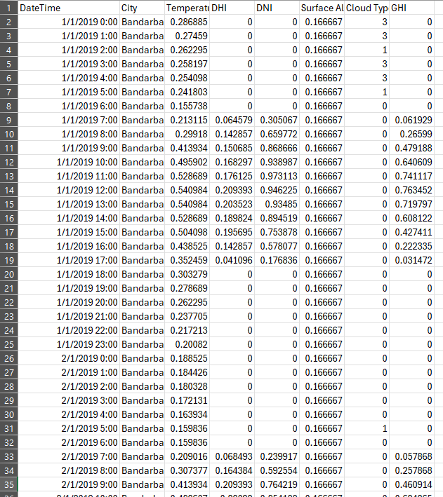
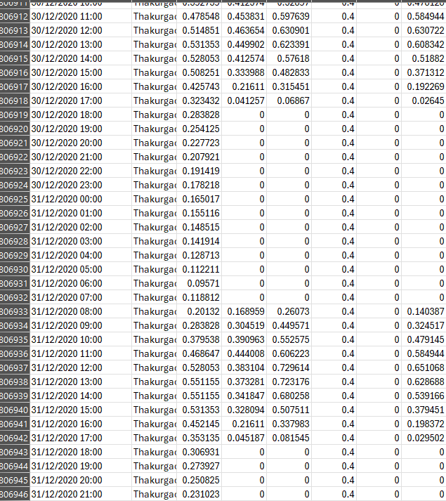
Dataset

Slide 9
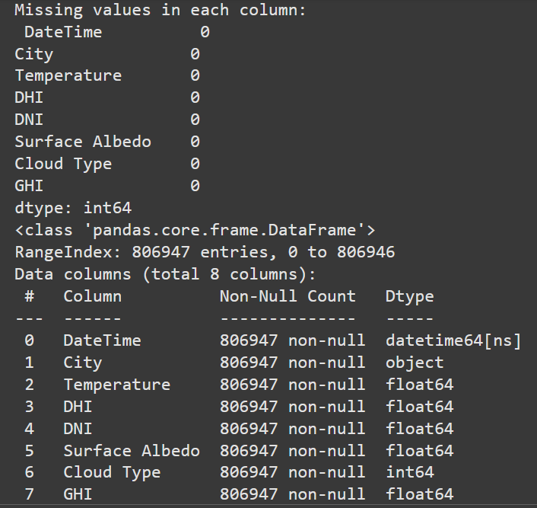
Dataset description

Slide 10
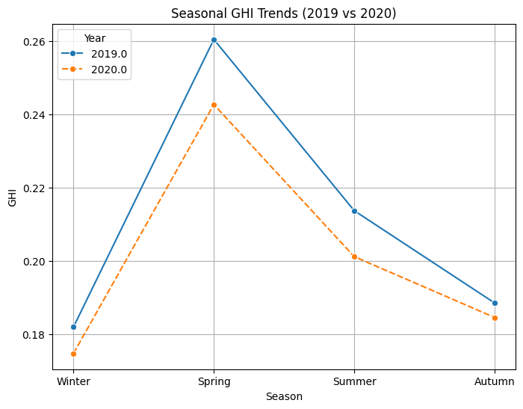
Seasonal image pattern

Slide 11
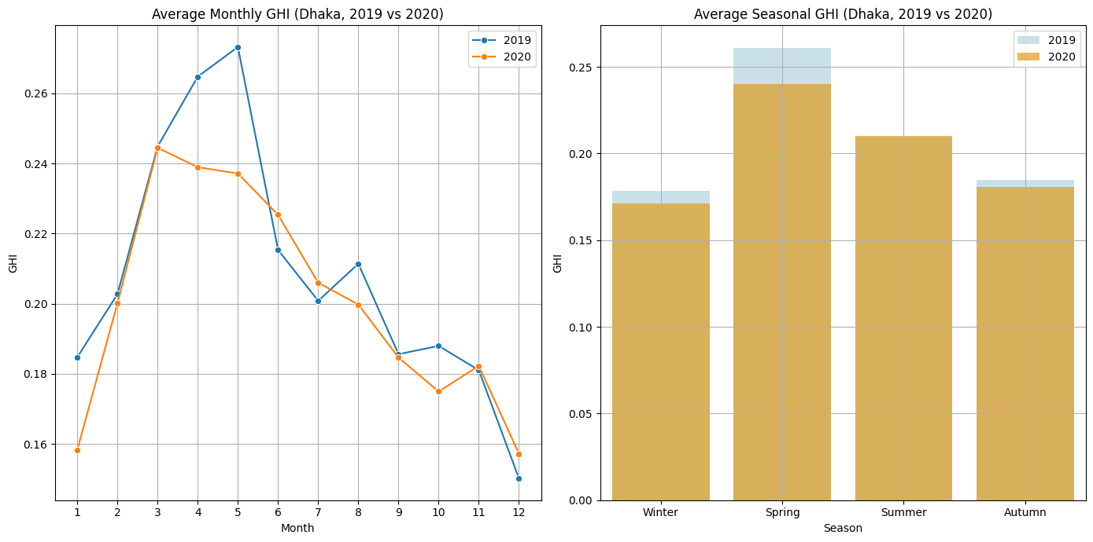
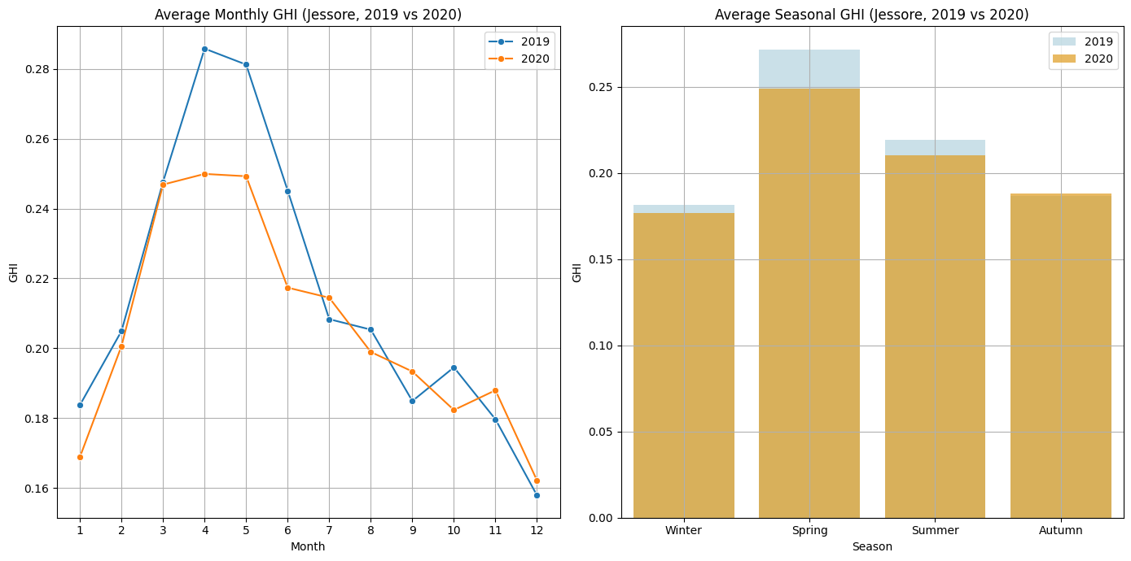
Seasonal image pattern

Slide 12
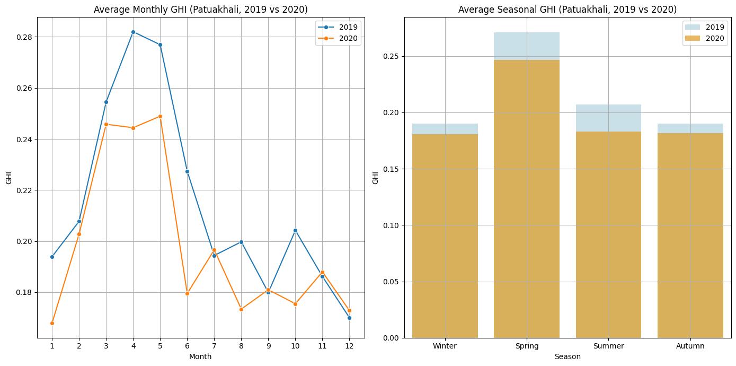
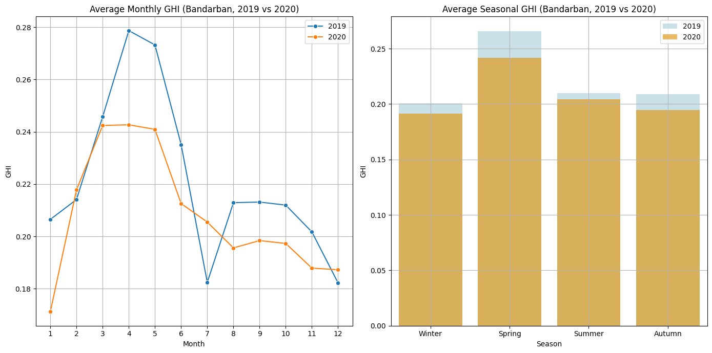
Seasonal image pattern

Slide 13
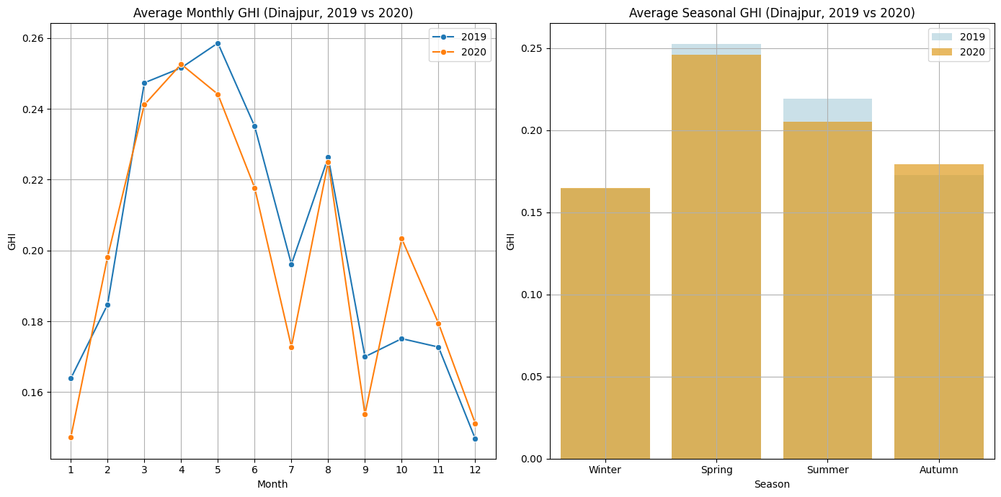
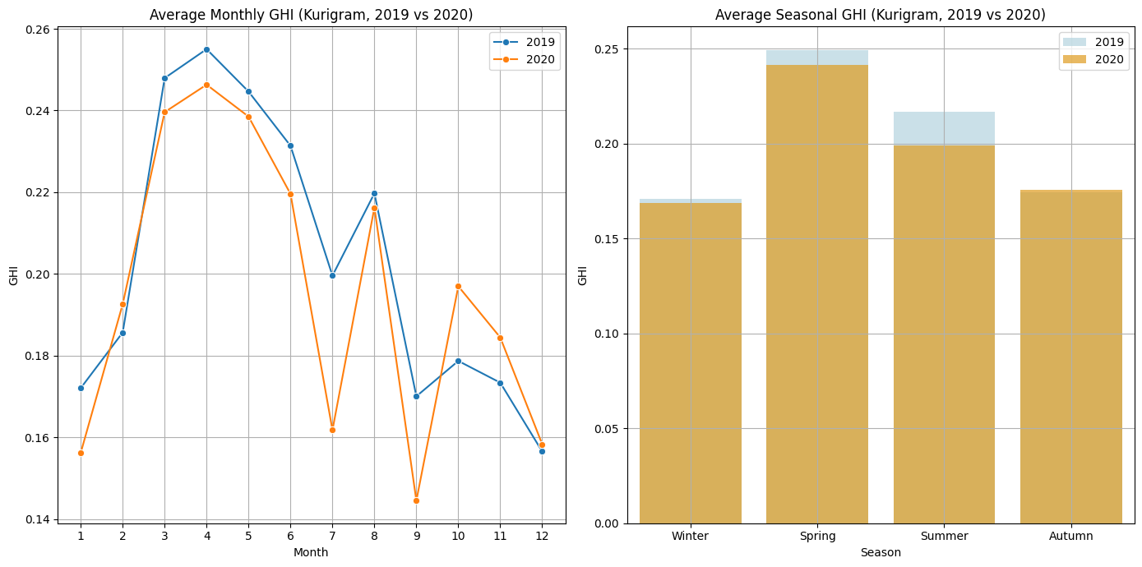
Seasonal image pattern

Slide 14
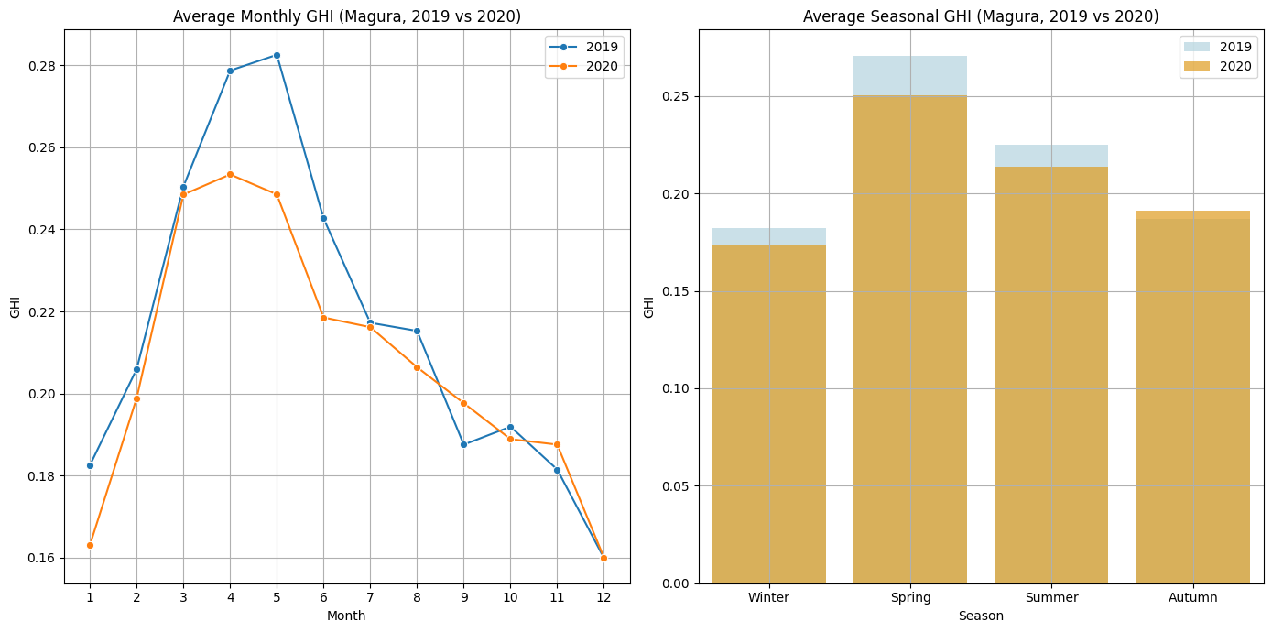
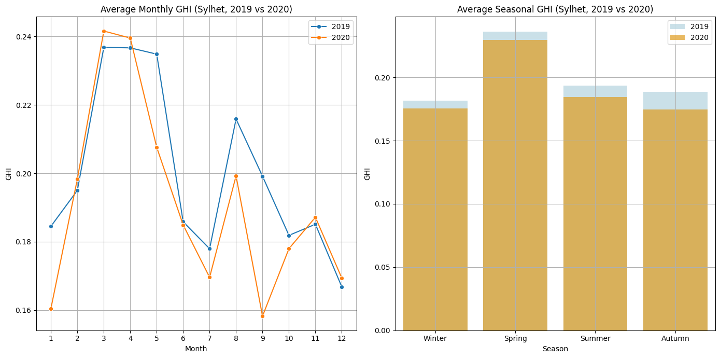
Seasonal image pattern

Slide 15
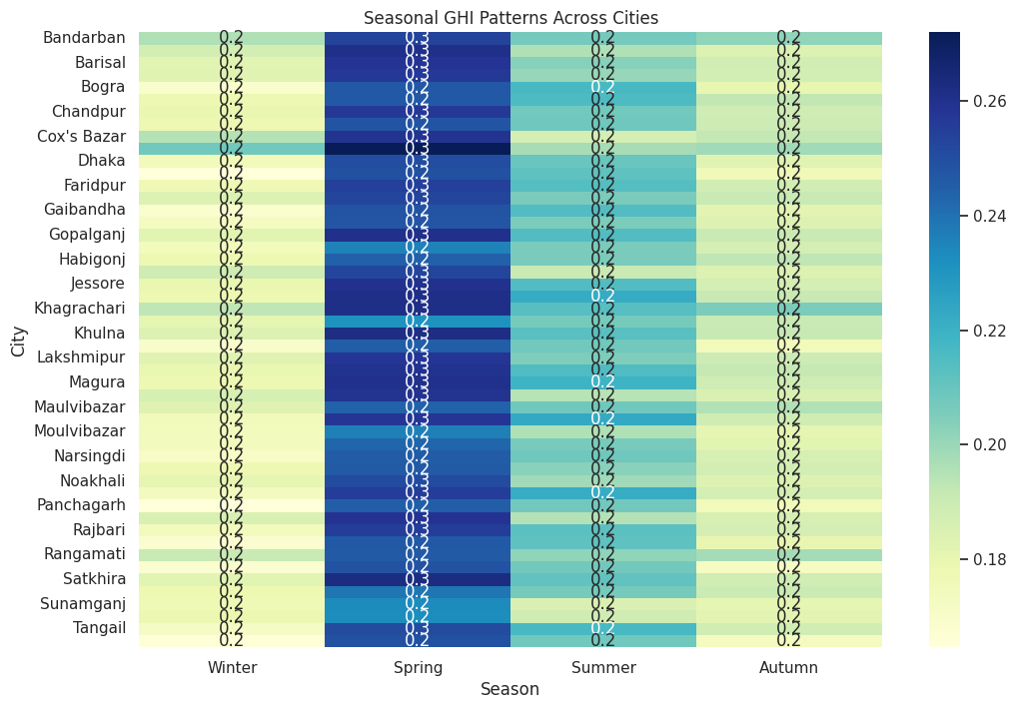
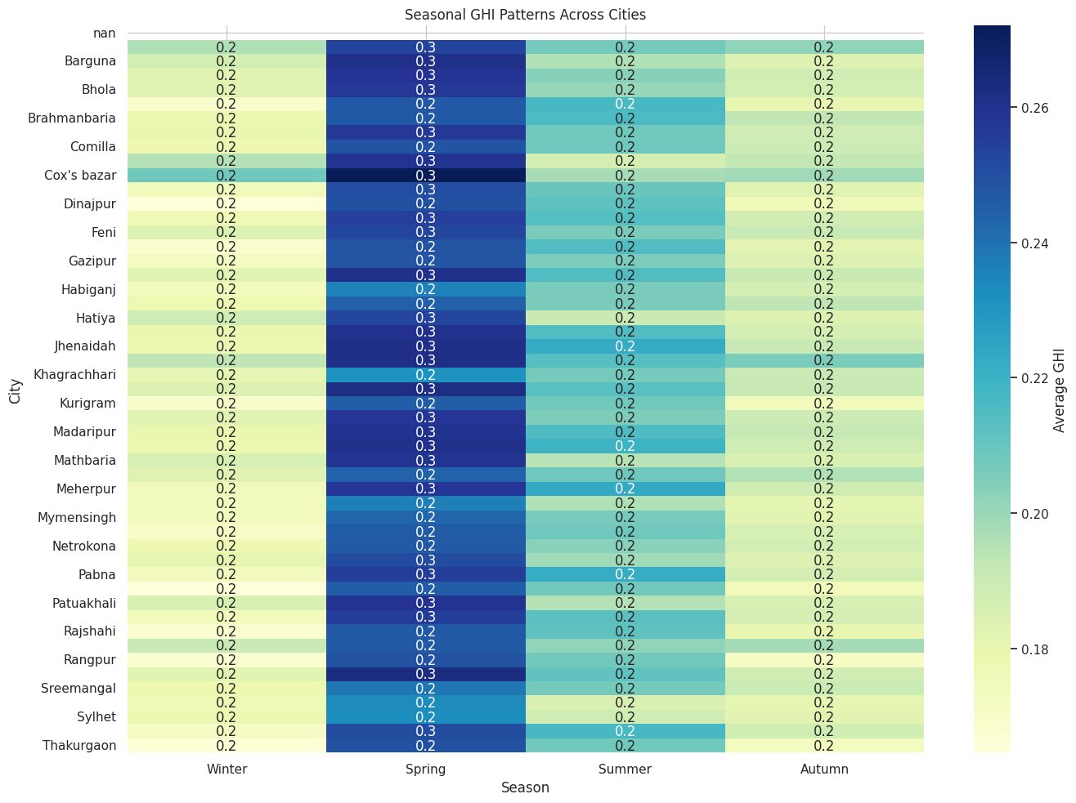
Seasonal image pattern(Heatmap)

Slide 16
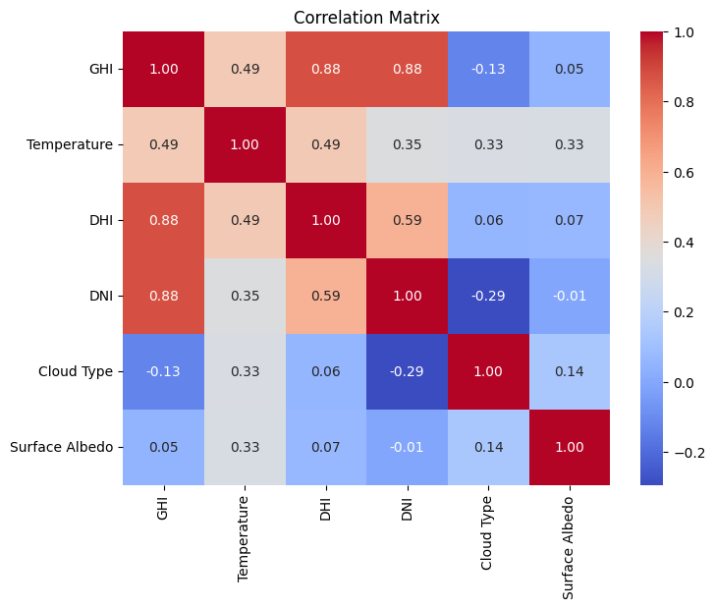
Correlation Matrix

Slide 17
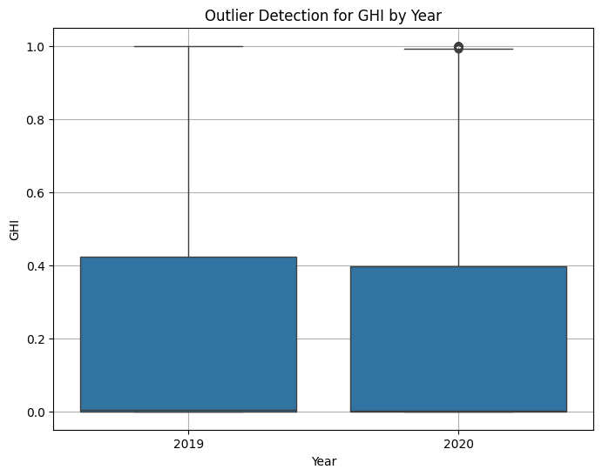
Outlier Detection for GHI by Year

Slide 18
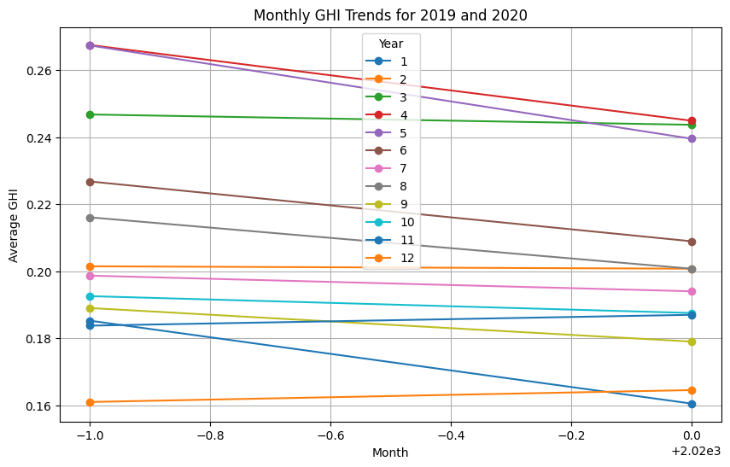
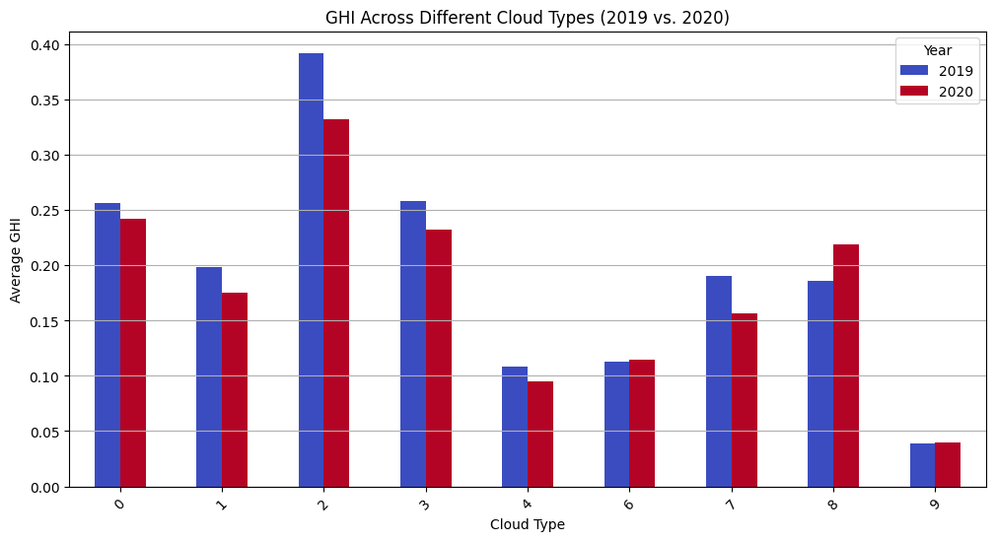
GHI Across Different Cloud Types (2019 vs. 2020)
Monthly GHI Trends (2019 and 2020)

Slide 19
SPLITTING THE DATASET
Dependent Columns:
[‘GHI']
Independent Columns:
[‘TEMPERATURE', ‘DHI', ‘DNI', ‘SURFACE ALBEDO', ‘CLOUD TYPE’]

Slide 20
RESULT
MODELS | Mean Absolute Error (MAE) | Root Mean Squared Error (RMSE) | Success rate (R2_score)
Linear Regression | 0.03417 | 0.05296 | 96.583%
Random Forest | 0.02246 | 0.04553 | 97.475%
Gradient Boosting | 0.09072 | 0.11589 | 83.639%
Decision Tree | 0.02350 | 0.04754 | 97.246%
XGBoost | 0.01226 | 0.02039 | 99.493%

Slide 21
Discussion
Among all the models tested, XGBoost demonstrates the best performance with:
The lowest Mean Absolute Error (MAE) of 0.01226.
The lowest Root Mean Squared Error (RMSE) of 0.02039.
The highest success rate (R² score) of 99.493.
Random Forest and Decision Tree also perform well,
with high R² scores (0.97475 and 0.97246, respectively) and relatively low error rates, making them strong alternatives.

Slide 22
conclusion
Optimal Model for Prediction: XGBoost emerged as the most effective model for predicting optimal solar panel locations in Bangladesh, achieving the highest success rate (R² score: 0.99493) and the lowest error rates (MAE: 0.01226, RMSE: 0.02039). This highlights its robustness and suitability for handling the complexity of the dataset.
Insights from Other Models: Random Forest and Decision Tree also performed well, providing strong alternatives with high accuracy and minimal errors. However, Gradient Boosting and Linear Regression were less effective, suggesting limitations in handling the data patterns.
Key Takeaway: Machine learning models, particularly XGBoost, offer significant potential for accurately predicting locations based on GHI values, enabling informed decisions for solar energy deployment.
Future Scope: Further research could involve incorporating additional environmental and socio-economic factors into the dataset, as well as exploring hyperparameter tuning and ensemble methods for further improvement.
This conclusion aligns with the goal of optimizing renewable energy solutions for a sustainable future in Bangladesh.

Slide 23
references
[1] Hiremath, S. V., Naik, R., Naik, S., Shettar, S., & Chachadi, K. (2024). GHI Prediction Based on Weather Data Using Machine Learning. 2024 IEEE International Conference on Information Technology, Electronics and Intelligent Communication Systems (ICITEICS), Karnataka, India.
[2] Jong, F. C., & Ahmed, M. M. (2024). Multi-Criteria Decision-Making Solutions for Optimal Solar Energy Sites Identification: A Systematic Review and Analysis. IEEE Access, 12, 143458–143463.
[3] Chodakowska, E., Nazarko, J., Nazarko, Ł., Rabayah, H. S., Abendeh, R. M., & Alawneh, R. (2023). ARIMA Models in Solar Radiation Forecasting in Different Geographic Locations. Energies, 16(13), 5029
[4] Islam, M. A., & Sohan, M. R. (2024). Enhanced Solar Radiation Prediction with Machine Learning: A Comprehensive Analysis of Meteorological Data Using Random Forest. 15th International IEEE Conference on Computing, Communication, and Networking Technologies (ICCCNT), IIT-Mandi, Himachal Pradesh, India.
[5] Hayajneh, A. M., Alasali, F., Salama, A., & Holderbaum, W. (2024). Intelligent Solar Forecasts: Modern Machine Learning Models and TinyML Role for Improved Solar Energy Yield Predictions. IEEE Access.
[6] Udo, W. S., Kwakye, J. M., Ekechukwu, D. E., & Ogundipe, O. B. (2023). Predictive Analytics for Enhancing Solar Energy Forecasting and Grid Integration. Engineering Science & Technology Journal, Vol. 4, Issue 6, pp. 589–602.
[7] Suwanwimolkul, S., Tongamrak, N., Thungka, N., Hoonchareon, N., & Songsiri, J. (2024). Developing a Thailand Solar Irradiance Map Using Himawari-8 Satellite Imageries and Deep Learning Models. 2024 IEEE Conference on Energy Systems and Environment (ICSEE), Chulalongkorn University, Bangkok, Thailand.

Slide 24
Thank you

